Slide 1
MALE REPRODUCTIVE ORGANS

Slide 2
Male reproductive system
In male, the reproductive system is closely related to the urinary system.
The urethra is shared by the urinary and genital systems.
The male reproductive organs include the external and internal genitalia.

Slide 3
The external genitalia or genital organs
  The penis
  The scrotum
  The testis and epididymis
  The spermatic cord
The internal genital organs
  The vas deferens or the ductus deferens
  The seminal vesicle
  The ejaculatory duct
  The prostate
  The urethra.

Slide 4
Testis
Testis is suspended in the scrotal sac by the spermatid cord and covered by scrotal layers.
Shape and dimensions
Testes is oval in shape. Left testis lies about 1cm lower than right testis.
Length 5cm, breadth-2.5cm, thickness- 3 cm
Weight- 10-14 gm

Slide 5
External features
Testis has two poles- upper and lower
2 borders- anterior and posterior
2 surfaces- medial and lateral

Slide 6
Coverings of testis
3 coats
Outer most- tunica vaginalis
The middle- tunica albuginea
The inner- tunica vasculosa
( describe detaily about each layer- refer text book)

Slide 7
Structure of testis
The testis is divided into 200-300 lobules by numerous septa that arise from the mediastinum testes. With in each lobule there are 2-3 seminiferous tubule.
The interstitial cells of leydig present in the seminiferous tubule . These cells secrete male sex hormone- testosterone.

Slide 8
Seminiferous tubule
An uncoiled seminiferous tubule is about 70-80 cm in length
There are two varieties of cells in the seminiferous tubule-
  Spermatogenic cells: these cells represent different stages in the formation of spermatozoon. It includes spermatogonia-primary spermatocytes-secondary spermatocytes-spermatids-spermatozoa

Slide 9
  Sertoli cells: these cells support and nourish the spermatogenic cells.

Slide 10
Arterial supply
Testicular artery- it is a direct branch of abdominal aorta.
Venous drainage
Drained by pampiniform plexus of veins, which later unite to form the testicular vein, which drains into IVC and to renal vein.
Lymphatic drainage
Testes drains into pre and para aortic group of lymph nodes. Scrotum drains into superficial inguinal lymph nodes.

Slide 11
Applied aspects
Cryptorchidism : It is a congenital condition in which one or both testes fail to descend into the scrotum. Testes may be in the inguinal canal or in the pelvis.
Varicocele: varicose veins in the pampiniform plexus of the spermatic cord which can lead to low sperm count or sterilty.
Hydrocele: swelling of the scrotum, caused by excessive accumulation of fluid in the cavity of tunica vaginalis.

Slide 12
Epididymis
This is a coma shaped mass,made up of highly coiled tube.
The epididymis applied to the superior and posterio lateral surfaces of testes.
The sperms are stored in the epididymis, where they undergo final stage of maturation.
The tail of the epididymis is continuous with the ductus deferens( vas deferens)

Slide 13
Parts
It has 3 parts
Head, body and tail
The superior expanded part of epididymis is called head, which is composed of the coiled ends of the efferent ductules.They transmit the sperm from the testis to the epididymis.
The body of the epididymis consists of a highly coiled duct of epididymis.

Slide 14
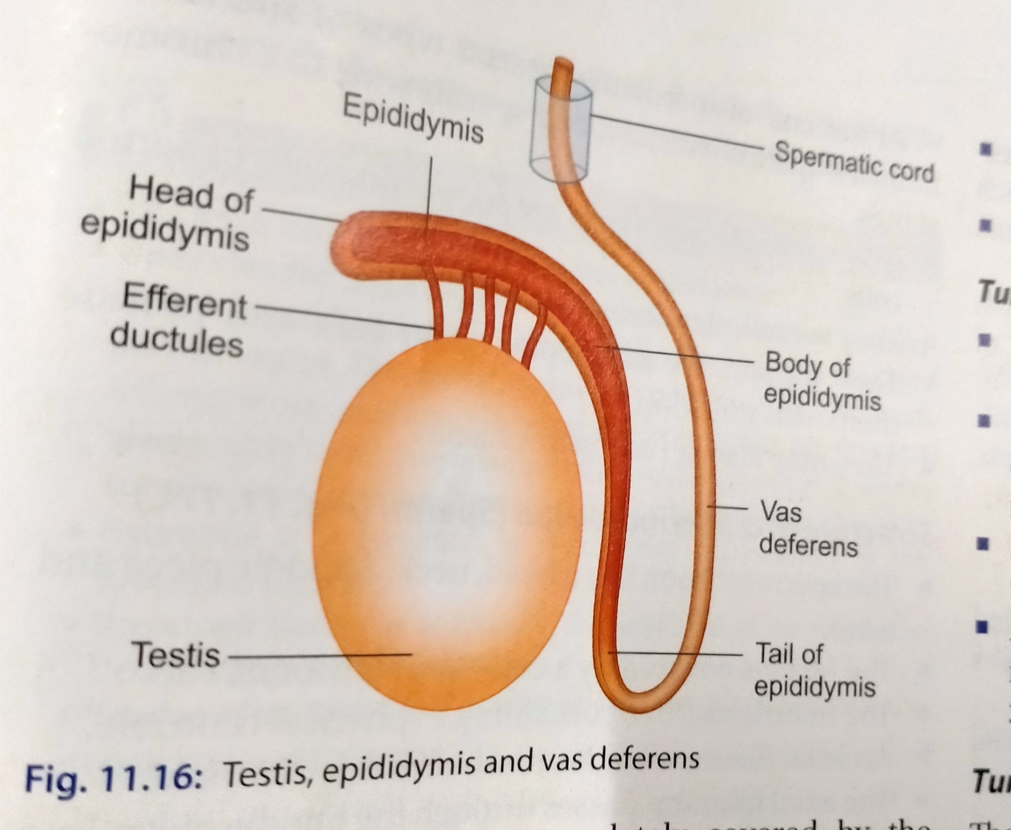

Slide 15
Vas deferens( Ductus deferens)
It is a thick walled muscular tube.
It is continuous with the duct of epididymis.
It begins in the tail of epididymis and ends by joining the duct of the seminal vesicle to form the ejaculatory duct.
The ductus deferens is about 45 cm long.
It transmits the spermatozoa from epididymis to the ejaculatory duct.

Slide 16
Structure
The wall of ductus deferens has 3 layers
Innermost mucous membrane
Middle muscular layer
Outer connective tissue layer

Slide 17
Cont…
The mucous membrane shows a number of longitudinal folds ,so that the lumen appears star shaped
Epithelium is simple columnar, in the extra abdominal part the cells are ciliated.
The muscle coat is very thick,consists of two layers- inner circular and outer longitudinal layers of smooth muscles.

Slide 18
Applied aspects
Vasectomy: bilateral ligation of the vas deferns is applied as one of the method of family planning.

Slide 19
Prostate gland
This is the largest accessory gland of the male reproductive system. Its secretions added to the volume of semen.

Slide 20
Position, shape and location
Prostate lies in the lesser pelvis below theneck of urinary bladder.
It resembles an inverted cone.
It has an apex, base and four surfaces- anterior, posterior and two inferolateral.
Measuring about 4cm transversely at the base, 3cm vertically, and 2cm antero posteriorly.
Weight- 8gms

Slide 21
Coverings
Inner true capsule
Outer false capsule
The space between true and false capsule is occupied by the venous plexus .

Slide 22
Lobes of prostate
Divided into 5 lobes by prostatic urethra and ejaculatory duct.
Anterior lobe: A small portion in front of the prostatic urethra.
Posterior lobe: it lies behind the prostatic urethra and below the ejaculatory duct.
Lateral lobes: they lie one on each sideof prostatic urethra.
Median lobe: above and in front of ejaculatory duct.

Slide 23
Zonal anatomy
Zonal anatomy of prostate has clinical importance .
Outer peripheral zone( about 70% of prostate tissue)- prone for carcinoma.
Central zone( 25% of prostate tissue)- it surrounds the ejaculatory duct and occupies posterior to upper prostatic urethra.
Transitional zone( about 5% of prostate tissue)- distal part of preprostatic urethra. BPH is more common in this area.

Slide 24
Blood supply
Arterial supply: inferior vesical artery, middle rectal artery, and internal pudental artery.
The veins from the prostatic plexus between true and false capsule drains into internal iliac vein.

Slide 25
Structure
Structurally the gland has a fibromuscular stroma which includes glandular tissue in the form of numerous follicles.
Each follicle is lined by columnar epithelium.
The follicle drains into 12-20 excretory ducts and it opens into the prostatic urethra.

Slide 26
Applied aspects
Benign Prostatic hypertrophy (BPH)- Enlargement of the prostate gland. The enlarged prostate compress the urethra and obstruct the urinary outflow.
TURP: Trans Urethral Resection of Prostate.

